Slide 1

Problem Statement:
Rush Estimator for Corporate Cafeteria

Slide 2

Team Leader Name: Bharath Team Members Name:
Vasanth
Sri Renugadevi
Mithun

Slide 3

IDEA/APPROACH DETAILS
Problem Statement:
To run a cafeteria, it is important that we have to estimate number of people visiting the Cafeteria at a particular time, because we have to make the necessary arrangements according to the rush and to avoid wastage of food. In this case till now a approximate count has been taken in account by the cafeteria management for making the necessary arrangement to handle the customers visiting cafeteria. This may cause wastage of food items and a financial loss to the management.

Slide 4
Proposed Solution:
Solution 1:
In this solution we are proposing Biometric Fingerprint to count the number of people visiting the cafeteria. To implement this employee data has to be collected from the college and to be stored in the data-base to count the average num of people visiting cafeteria in a day and this count will be stored in daily bases for a week. After a week a predictive analysis will take place to calculate the average num of people visiting cafeteria in a particular day(Ex : Mon – Avg count, Tue – Avg count….). Based on this result Required quantity of food can be prepared and profit growth can be achieved.

Slide 5
Solution 2:
As an enhancement of the previous solution we have implemented Facial recognition using AI to count the number of people visiting the cafeteria. As mentioned before data will be collected and stored in the data base to count the number of people visiting the cafeteria. This Facial AI will recognize the face pattern of humans to take the count and the count will be stored on daily basis for a week. At the weekend a predictive analysis will take place to calculate the average num of people visiting cafeteria in a particular day. Based on the weekly report Required quantity of food can be prepared and served to the customers and more over profit growth can be achieved.

Slide 6
Solution 3:
Comparing with the past two solution we can make some advancement in our solution in future by implementing RFID with the help of IOT devices to count the number of people visiting the cafeteria. The RFID reader is a network-connected device It uses radio waves to transmit signals that activate the tag. Once activated, the tag sends a wave back to the antenna, by that time the count can be taken and will be stored in the data base. . At the weekend a predictive analysis will take place to calculate the average num of people visiting cafeteria in a particular day. Based on the weekly report Required quantity of food can be prepared and served to the customers and more over profit growth can be achieved. However this method requires high cost for the installation. Depends on the financial support this efficient method can be implemented.

Slide 7
Technology :
Finger Print :
Java, Js
Mysql database
Facial Recognition:
AI
Python
Mysql database
RFID :
RFID
RFID reader
Mysql database

Slide 8
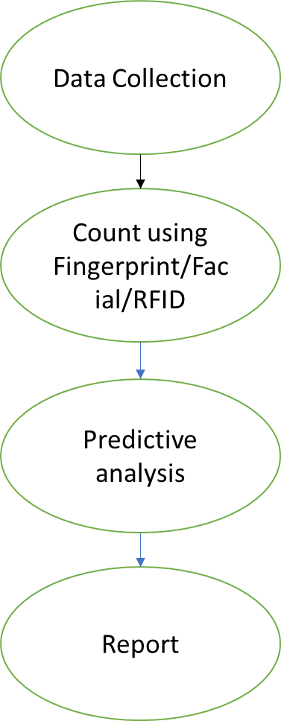
Use Case:

